Slide 1
How to Schedule a Zoom Meeting
Iphone App Edition

Slide 2
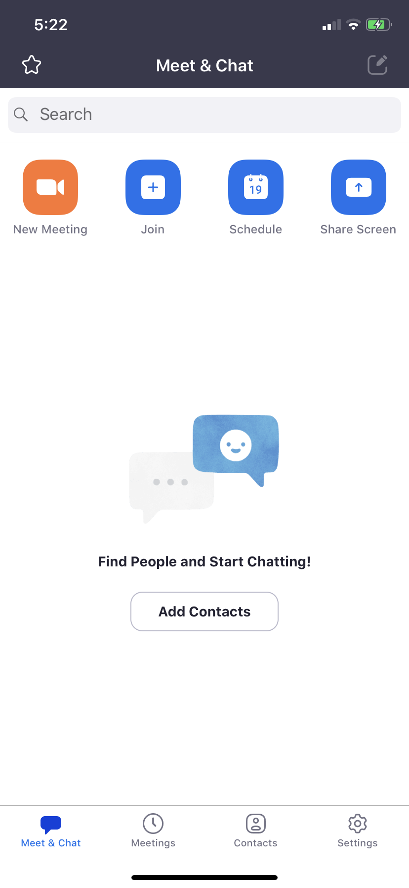
Step 1:
To schedule a meeting in advance, click the calendar “schedule”
To start an impromptu meeting, click the “new meeting.”
To join a meeting scheduled by someone else click “join”

Slide 3
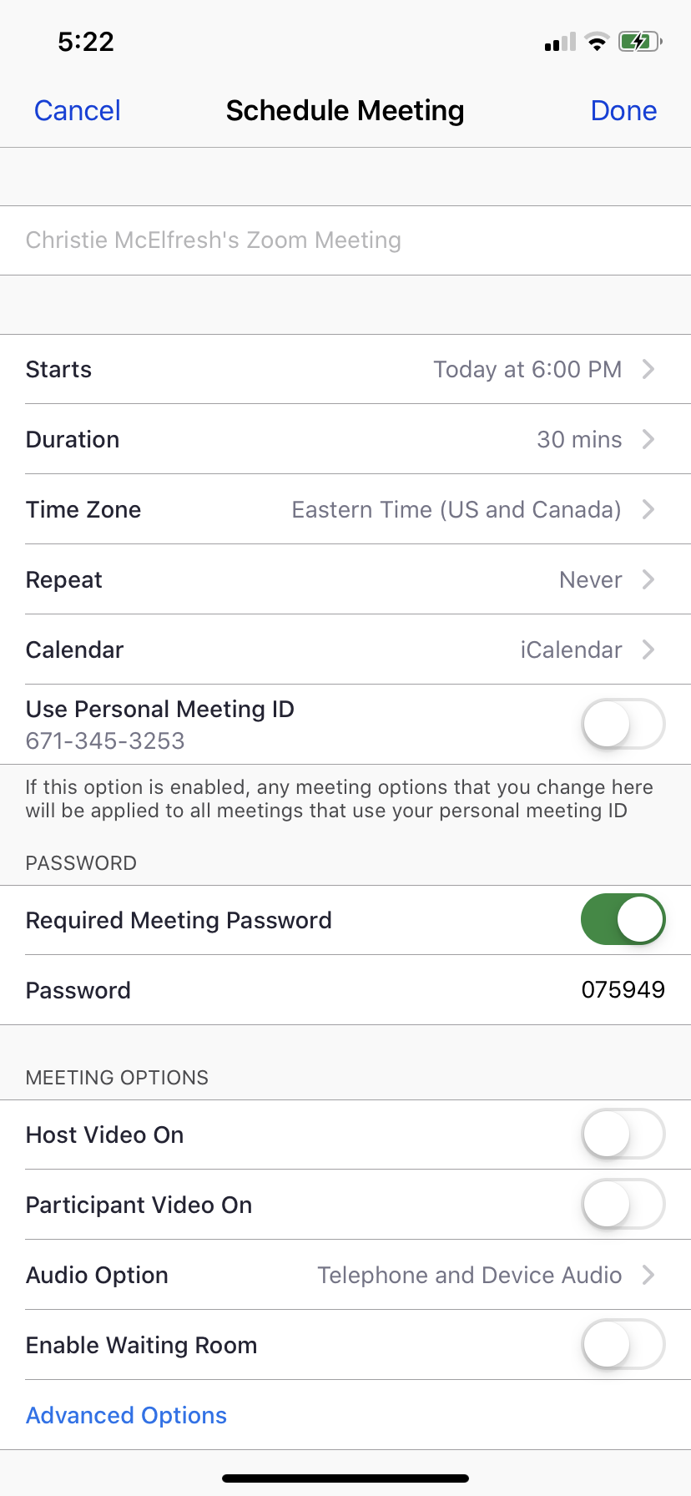
2. Schedule Meeting
Name your meeting in the open line at the top.
Select a start time
Select a duration
Make sure your time zone is set to Eastern
Make sure repeat says NEVER unless you have a weekly meeting you want repeated
You may choose a calendar for your meeting to sync with
Make sure Personal ID is toggled OFF (like on the screen)

Slide 4
2. Schedule Meeting
Password: I would toggle password to “Off” (mine is currently on)
Under Meeting Options:
Toggle host video “ON” (mine is off)
Toggle participant video “ON” (mins is off)
Make sure audio option has both telephone and device
Enable a waiting room if you want. This allows you to start the meeting and accept participants in as you want.

Slide 5
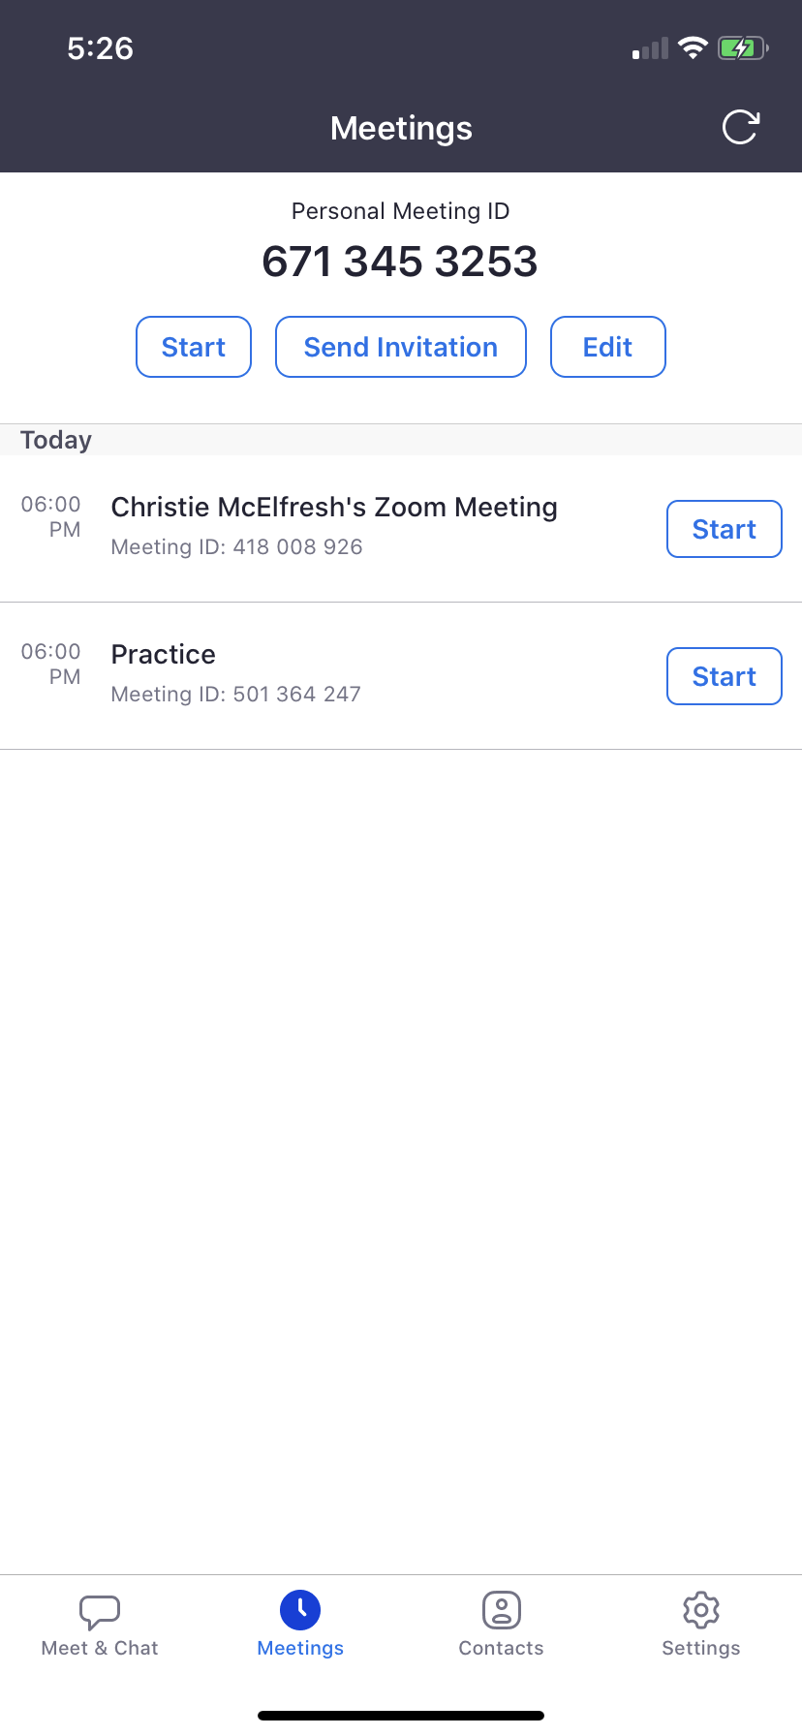
3. Add People
Click on the meeting you would like to add people.
I clicked on “Practice”

Slide 6
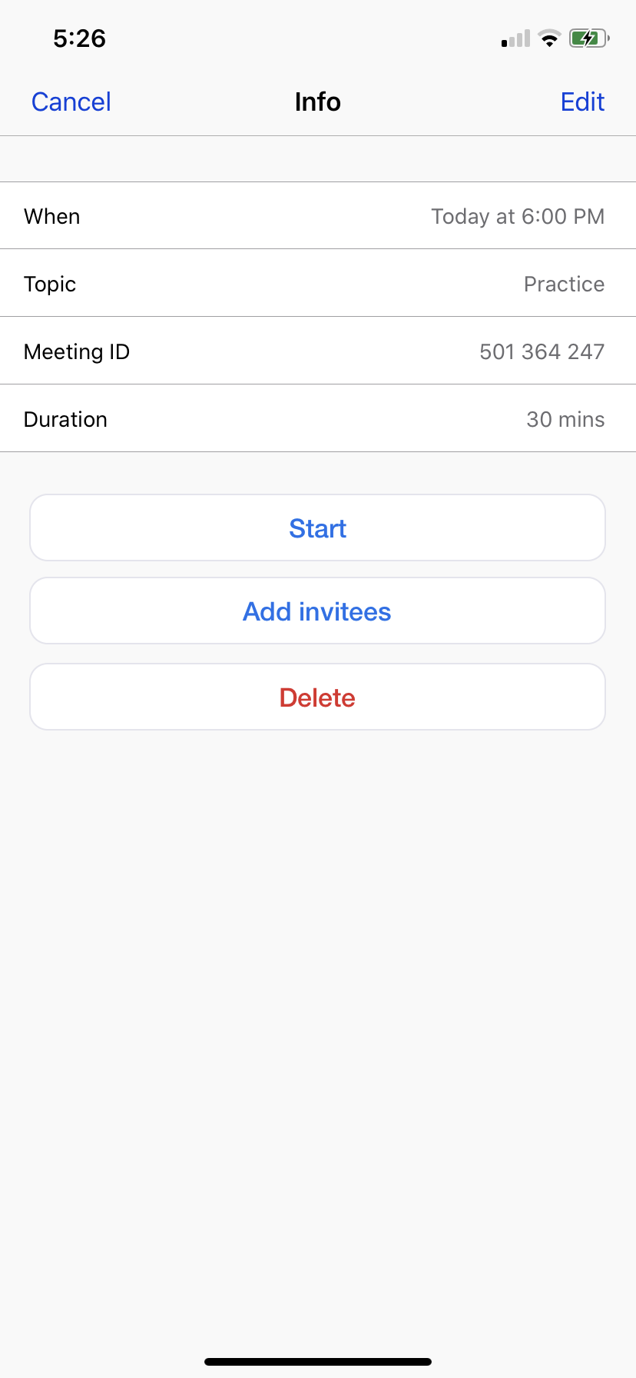
3. Add People
Click “Add Invitees”

Slide 7
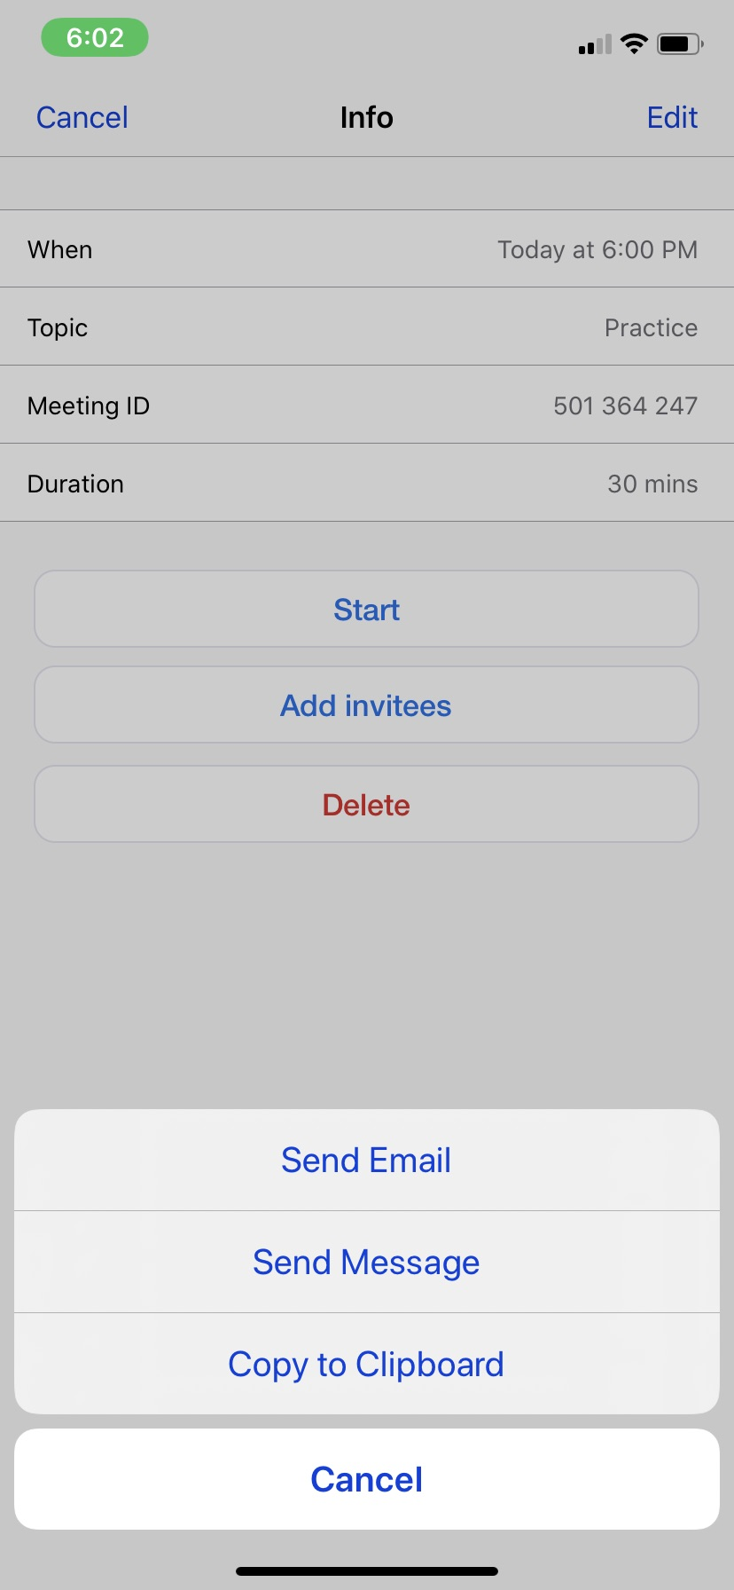
3. Invite
From here, you can decide how you want to invite your guests. You can send an email or send a message.
If you choose copy to clipboard, you can go into your email app and then paste the invite and add recipients that way as well.
(This is the option I like best because my email addresses automatically pop up)

Slide 8
Voila!
You are officially a zoom scheduling master!
Access your scheduled meetings on the home screen under “meetings”

